Slide 1
KrigR – Downscaling State-of-the-Art Climate Data for Macroecologists
Erik Kusch, PhD Student Department of Biology Section for Ecoinformatics & Biodiversity
Center for Biodiversity Dynamics in a Changing World (BIOCHANGE) Aarhus University

Slide 2
What Do We Want From Our Data?
Why do we need high-resolution climate data?
Spatial Resolution:
“microclimatic processes [...] affect broad-scale ecological processes” ~ Lembrechts & Lenoir, 2019
Temporal Resolution:
“more accurate variability and extreme event statistics are simulated by higher spatial and temporal resolution models” ~ Fowler et al., 2007
How do we explain the complex natural world?
Macroecology has largely focussed on Air Temperature and Precipitation Data
This neglects the vast information contained within other climate parameters such as the Essential Climate Variables (ECVs)

Slide 3
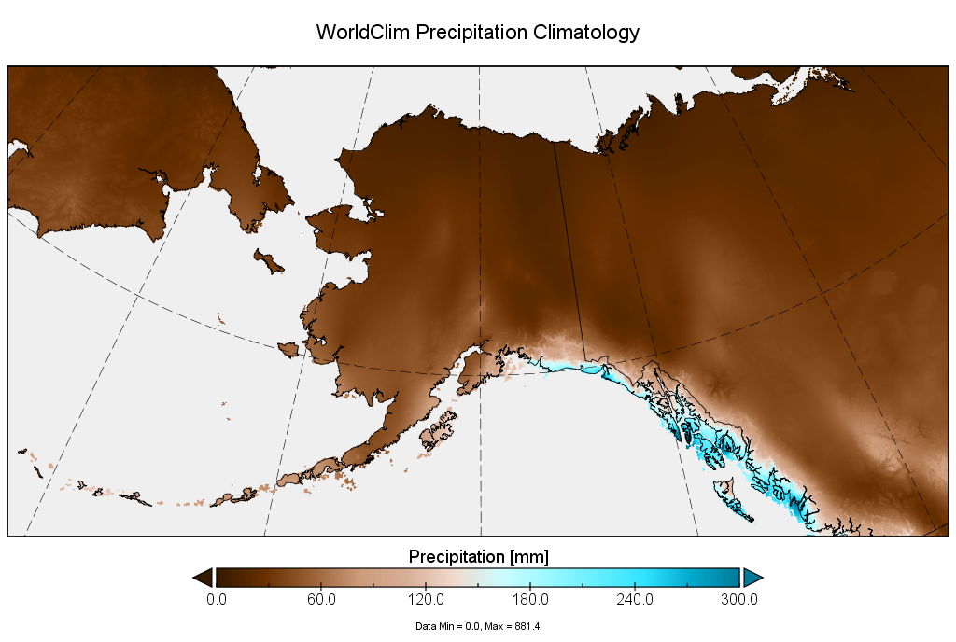
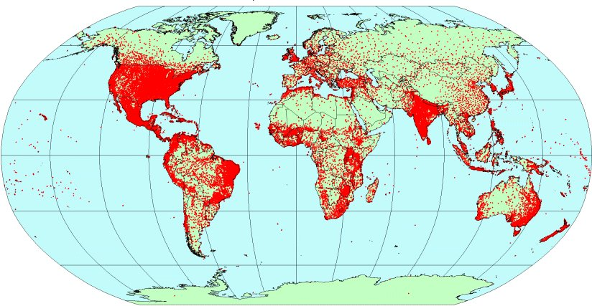
Contemporary Data - Accuracy
→ There are large areas of low data reliability in our gridded-observation data sets

Slide 4
The Climate Data We Use
Gridded Observations:
Single-location measurements
Aggregated and interpolated to fit grid
Shortcomings:
Limited coverage
Subject to biases (systematic, drift)
Uncertainties due to
Conversion from satellite data
Homogenization process
Interpolation methods
Inconsistencies between different datasets
Examples of datasets for temperature¹ and precipitation²
Name | Spatial resolution | Temporal resolution | Period covered
CRUTv4¹ | 5º x 5º | Monthly | 1850 - present
GHCNv3^{1,2} | 5º x 5º | Monthly | 1880 – 2016
NOAA¹ | 5º x 5º | Monthly | 1880 - present
GISTEMP¹ | 2º x 2º | Monthly | 1880 - present
GHCN_CAMS¹ | 0.5º x 0.5º | Monthly | 1948 - present
UDelaware^{1,2} | 0.5º x 0.5º | Monthly | 1900 - 2017
WorldClim2^{1,2,}* | 0.042º x 0.042º | Monthly | 1960 - 2018
CPC Global^{1,2} | 0.5º x 0.5º | Daily | 1979 - 2010
NOAA_land² | 0.5º x 0.5º | Monthly | 1948 - present
GPCP² | 2.5º x 2.5º | Monthly | 1979 - present
GPCC² | 0.5º x 0.5º | Monthly | 1891 - present

Slide 5
The Climate Data We Could Have
Climate Reanalyses:
Synthesis of models and observations
Used for climate process studies
Improvements:
All ECVs available from a single product
Dynamically consistent
No spatial or temporal gaps
Close match to a multitude of observations
Massive advancement in temporal resolution
Examples of global climate reanalyses
Name | Spatial resolution | Observations assimilated | Temporal resolution | Period covered
ERA5-Land | 0.1º x 0.1º | Ground-based & Satellite-born | Hourly & monthly | 1950* – present
ERA5 | 0.28º x 0.28º
JRA55 | 1.25º x 1.25º |  | 6 hourly & daily | 1958 – 2012
NCEP | 2.5º x 2.5º |  |  | 1979 - presemt
MERRA-2 | 0.5º x 0.5º |  | Hourly & 3 hourly & 6 hourly | 1980 - present
ERA-20C | 0.25º x 0.25º | Surface pressure | 3 hourly & 6 hourly | 1900 - 2010
*currently, ERA5 and ERA5-Land data is available going back to ~1980
→ Higher-resolution climate reanalyses are available for some regions

Slide 6
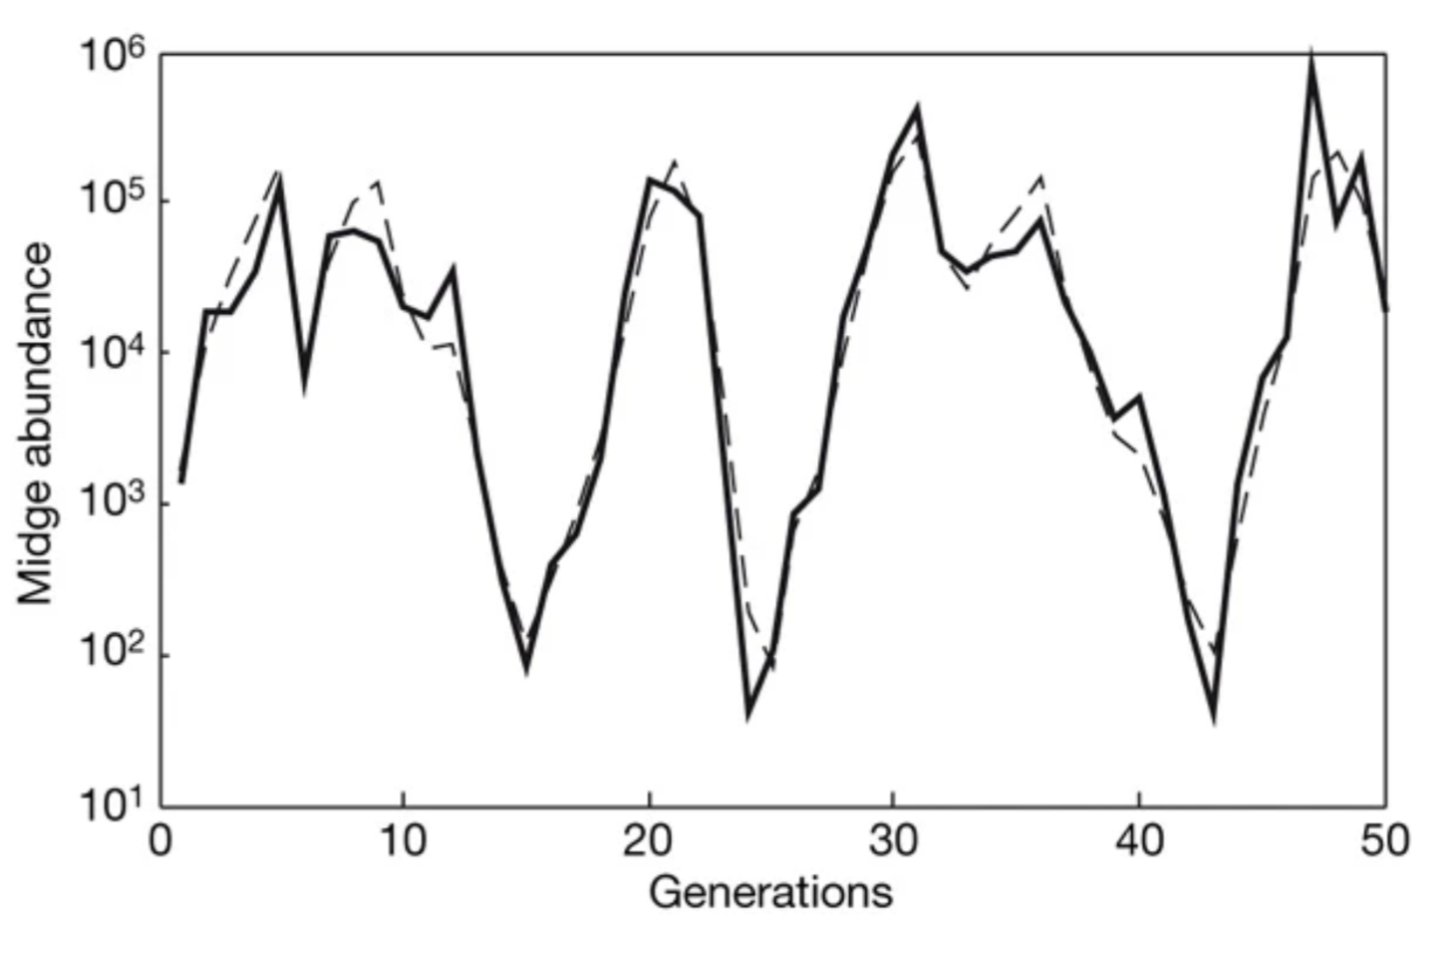
Contemporary Data – Temporal Resolution
“climate models consistently project increases in the year-to-year variance of precipitation” ~ Rudgers et al., 2018
“Failing to account for temporal variability also hinders quantification of exposure to extreme conditions” ~ Maclean, 2019
Biologically relevant gaps:
Extreme Events:
Neutral
Rapid
Growth
Rapid
Decline
© Connor Bernard
© Connor Bernard

Slide 7
Contemporary Data – Climate Parameters
ECVs offered by legacy data sets:
e.g.: WorldClim: ~26 variables
Mostly raw data and derivatives of:
Air Temperature
Precipitation
Data is rarely available at higher resolutions than monthly intervals
Much of this data is interpolated
Problematic with certain ECVs
Interpolation methods usually not made publicly available
ECVs offered by climate reanalyses:
e.g.: ERA5(-Land): ~83 variables
Covering all ECVs indexing important components of ecosystems such as:
Atmosphere
Soil properties
Data is available at hourly intervals
Data is derived from dynamic models:
Good fit to nature due to data assimilation practices
Models are fully disclosed
KrigR makes Climate Reanalyses available to you in R!

Slide 8
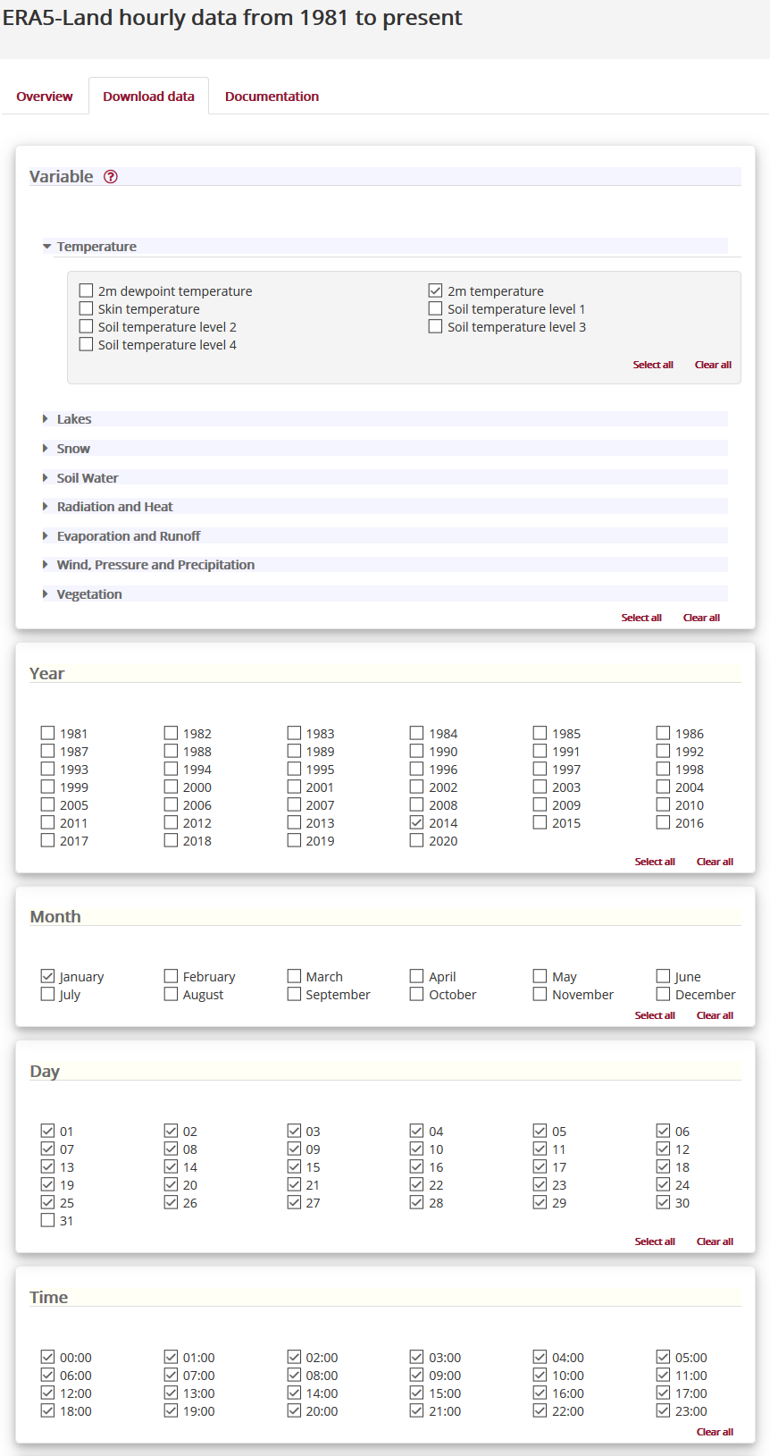
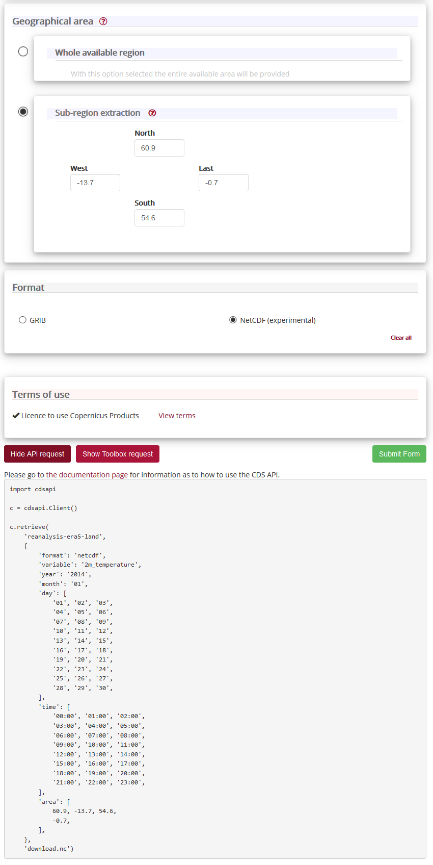
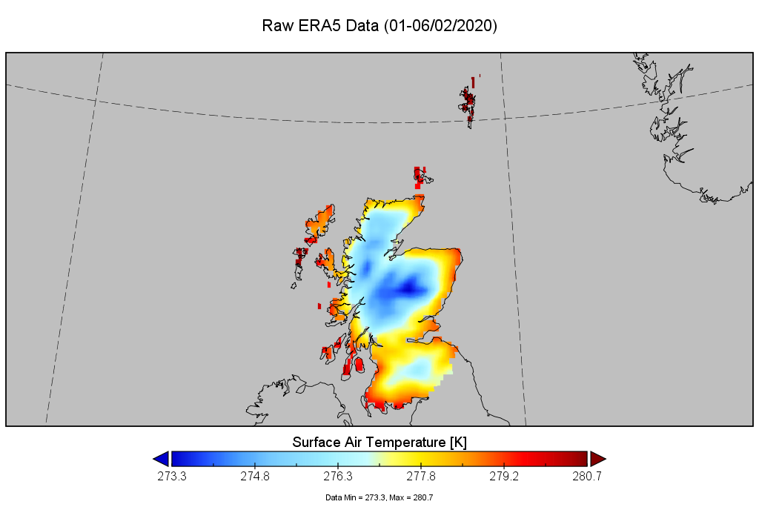
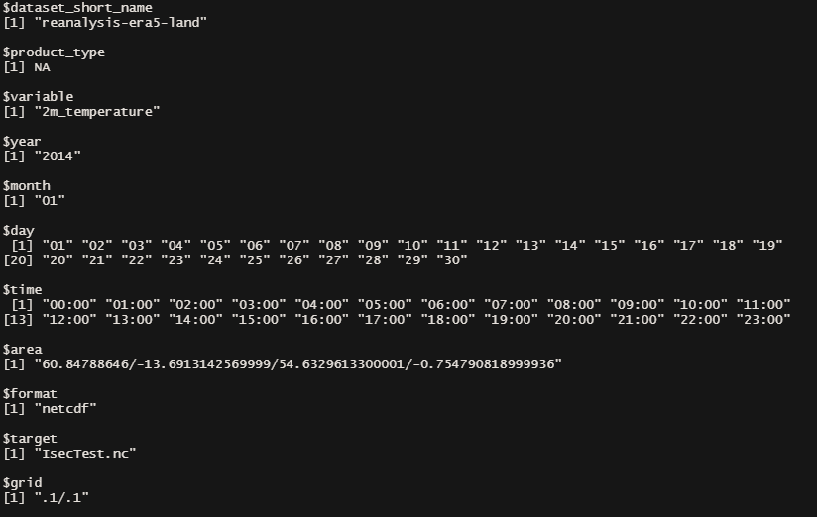
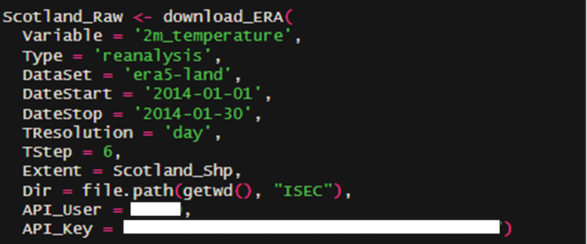
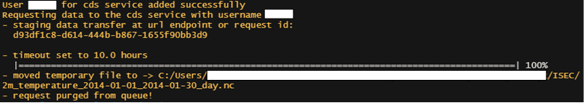
KrigR - Obtaining The Data
Download Prerequisits
CDS account & API key (generated here)
ecmwfr package:
Very unintuitive download specification
No processing of data
KrigR package:
Wrapper functions for ecmwfr package
More intuitive specification
Masking according to shapefiles
Aggregation to desired temporal resolutions

Slide 9
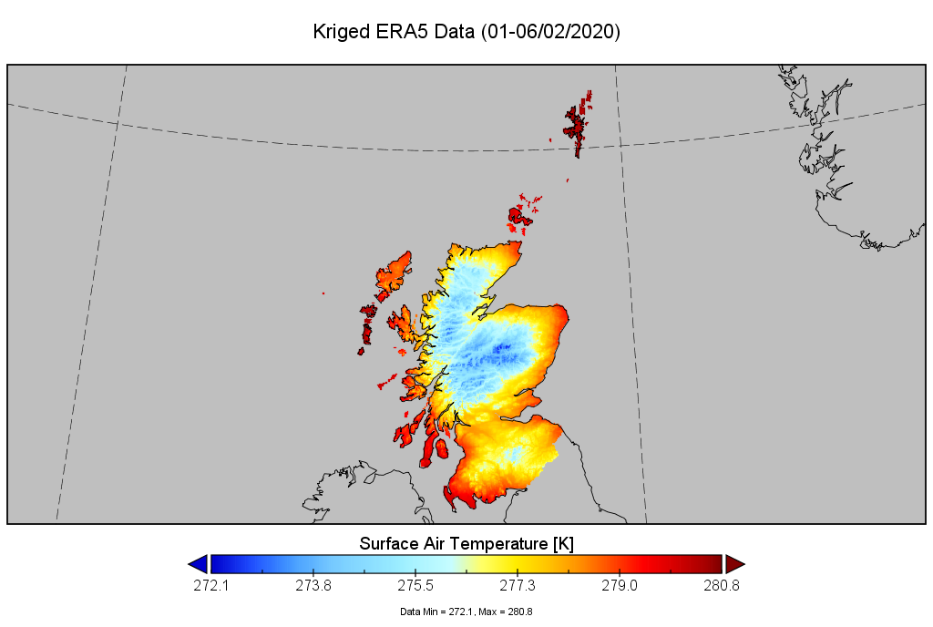
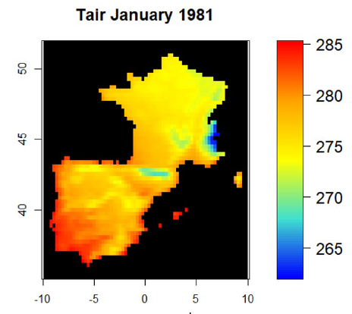
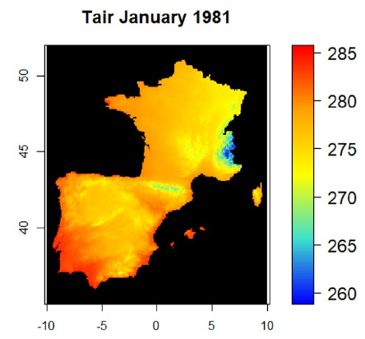
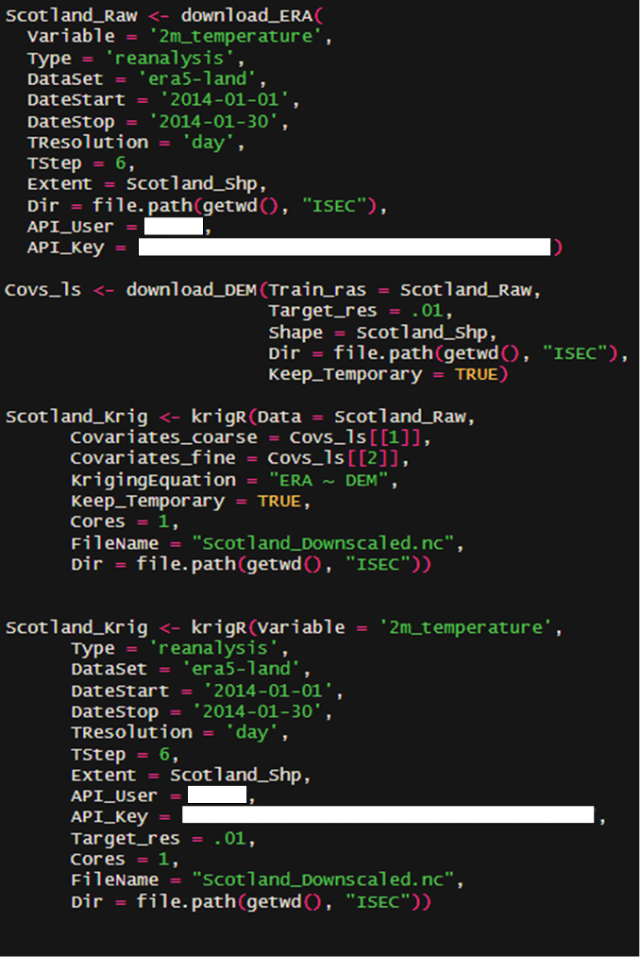
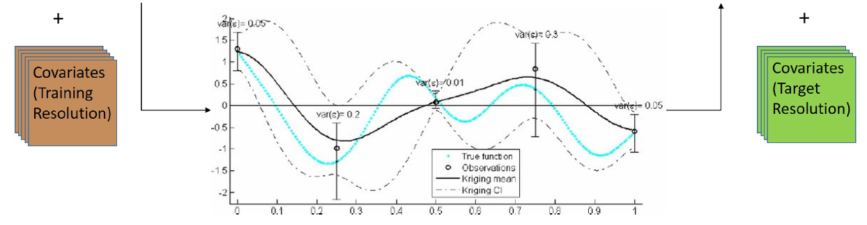
KrigR - Downscaling The Data
Kriging
Geostatistical downscaling method
Covariates at training & target resolution
automap package:
Kriging functionality in R
KrigR package:
Covariates (USGS GMTED 2010 DEM):
Donwload and pre-processing function
Kriging (automap wrapper):
Parallel processing of multilayer rasters
Added sanity checks before Kriging
Exporting of Kriging uncertainty
9

Slide 10
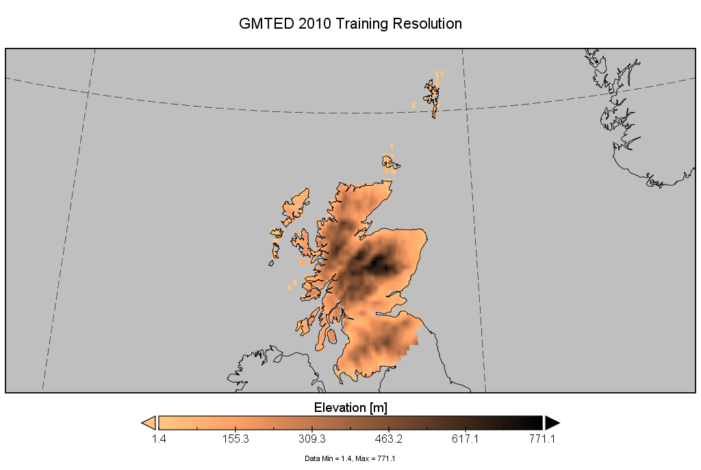
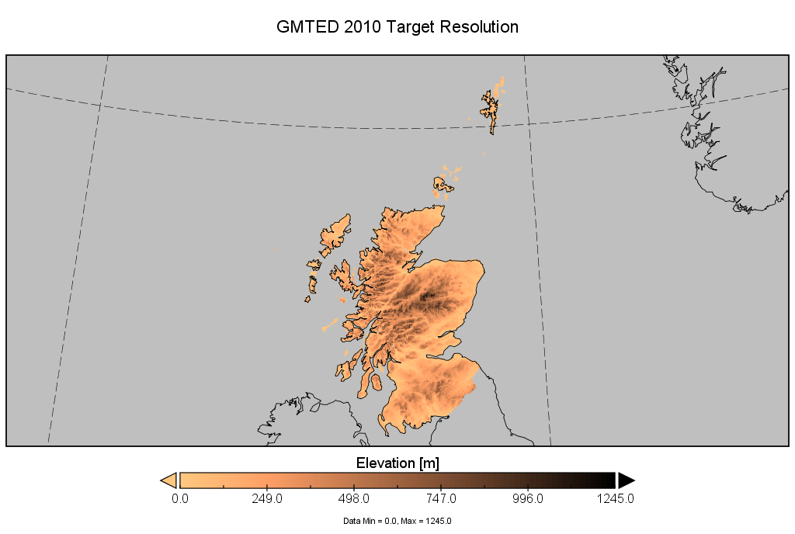
KrigR - R-internal Workflow (3 Steps)
Era5(-Land) Data / Spatial product
Climate Data
&
Covariates
Covariates
(Training Resolution)
&
Covariates
(Target Resolution)
Kriging
Downscaled Product
Downscaling Standard Error
&

Slide 11
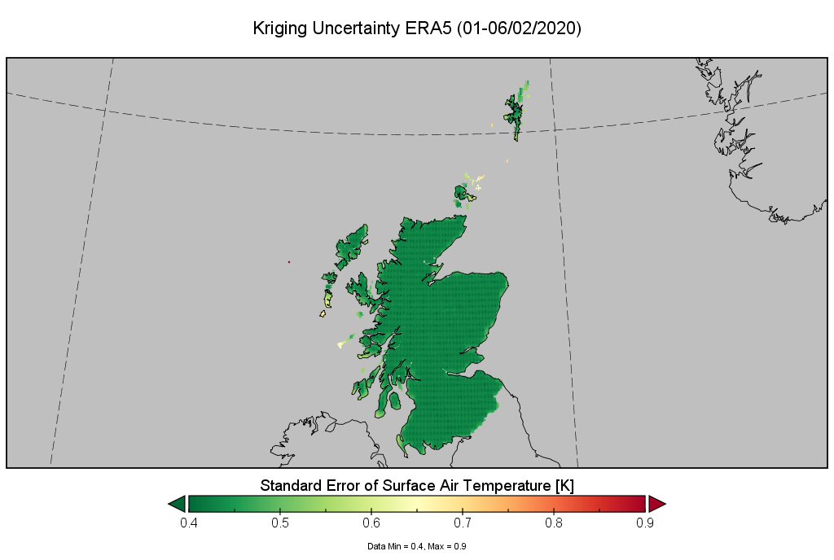
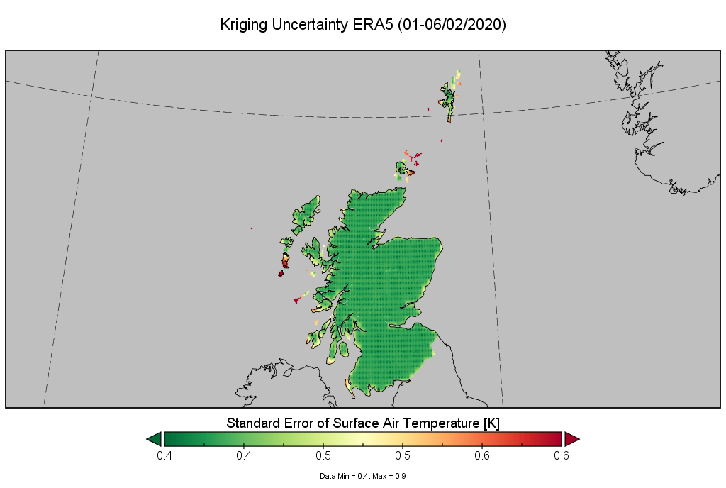
KrigR - R-internal Workflow (3 Steps)
Downscaled Product
Downscaling Standard Error
&

Slide 12
KrigR - R-internal Workflow (3 Steps)
Era5(-Land) Data / Spatial product
Climate Data
Third-party data
&
Covariates
Covariates
(Training Resolution)
&
Covariates
(Target Resolution)
Kriging
Downscaled Product
Downscaling Standard Error
&

Slide 13
KrigR - R-internal Workflow (Pipeline)
Entire KrigR WorkFlow in one function call

Slide 14
Using KrigR
What KrigR does:
Downloads ERA5(-Land) or UERRA data
Automatically breaks download request into sizeable chunks
Aggregates hourly/monthly data to user-specified temporal resolution
Masks data according to shapefile
Provides GMTED2010 data as covariates
Kriging of climate data
Checks for common errors
Parallelised processing of multi-bands
Exports kriging uncertainty
What KrigR does not do:
There is no variable selection for your analysis
Does not check whether your choice of covariates is sensible
Large regions are not automatically broken into smaller regions for local Kriging
Kriged data is not limited to realistic values, only statistically sensible values

Slide 15
Getting The Most Out Of KrigR
Consider your covariates
Consistency: Relationship of target variable & covariates across spatial/temporal scales
Colinearity: Exploit relationships between climate variables for Co-Kriging
→ Not all climate variables can be downscaled the same way
Computational cost
Processing time scales close to exponentially with extent and downscaling factor
Adding covariates only marginally increases computational cost
→ Downscale small regional products using many covariates.
Global/Large Region Kriging
Important relationships break down between the hemispheres
Computational cost prohibits us from doing this in one step
→ We can Krig global products in latitude bands or smaller tiles

Slide 16

Outlook
What did we gain?
R-integrated access to state-of-the art climate products
Complete workflow for advanced statistical downscaling of spatial products within R
How can you get it?
It’s on GitHub and ready to use
What’s still to come?
Intercomparison studies (planned publication)
KrigR for use in species distribution modelling (planned publication)
Application of KrigR in vegetation dynamics studies (submitted publication)
KrigR GitHub

